Slide 1
Event proposal Form

Slide 2
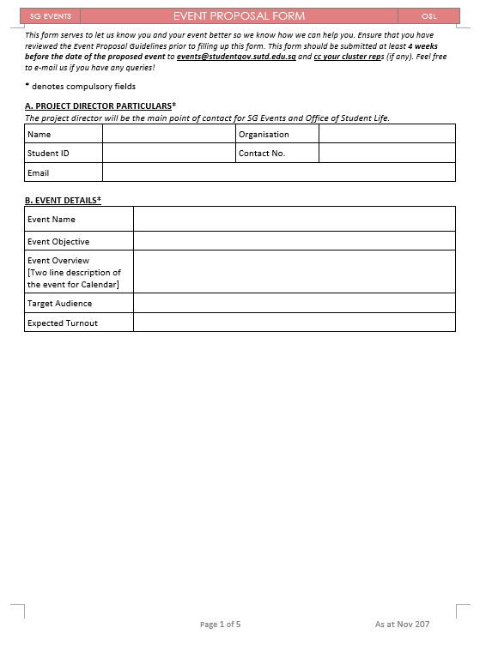

Slide 3
Filling in the Form
SUTD email
i.e. xxx@mymail.sutd.edu.sg
Please try to fill this in for us to better understand your event

Slide 4
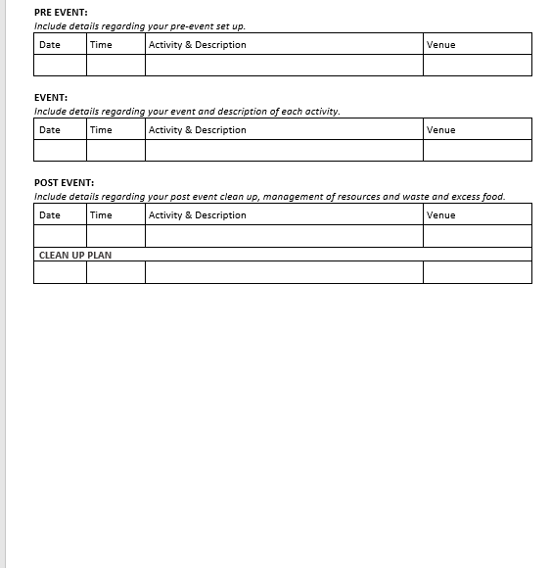
Filling in the Form
Confirm the date of your event
Confirm the time of your event
Pre-event includes setting up of the venue
Include as many details as possible regarding the event itself
Have a clean-up plan, including disposal and storage plan for remaining materials

Slide 5
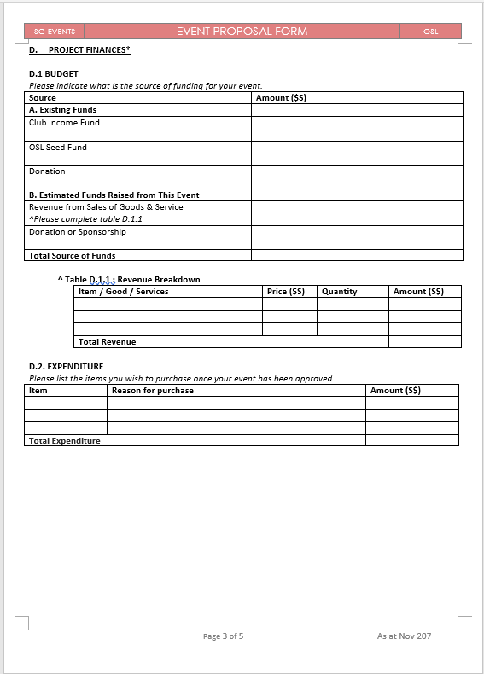
Filling in the Form
Fill in the source of your income
Ensure that this table if filled in if you are receiving any revenue
i.e. selling anything
Total expenditure for the event should tally with your total amount for funds

Slide 6
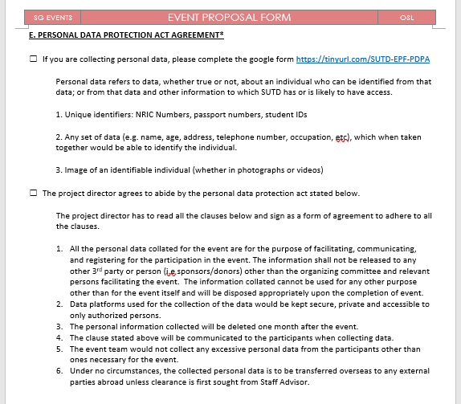
Filling in the Form
Make sure to indicate your agreement (as shown) if you are collecting any personal information for the event

Slide 7
Submitting Your EPF
Why submit to SG Events?
Collation of Events
Allows Events team to advise you on your event planning

Slide 8
Submitting Your EPF
What documents should be included?
EPF
Risk Assessment Form (RA Form)
Please submit your posters to SG Communications and not to SG Events

Slide 9
Events Logistics
Who do I look for regarding Event logistics?
Send an email to SG Events for the following logistics with your preferred time and date to pick up the items:
BBQ pits
Ice Box
We are unable to lend out any non-reusable items (e.g. paint, charcoal)
Please include the name and contact number of the person collecting the items

Slide 10
Event Queries
If you have queries regarding your event:
Send an email to SG Events OR
Send your query via message OR
Ask an Events team member
Send your emails to: events@studentgov.sutd.edu.sg
Send your messages to: 96321546

